Slide 1
Disease Classification:
Knowledge Graphs & GCNs
David Sherman & Janhavi Subedarpage

Slide 2
Goal & Background
Goal: To develop a model, using knowledge graphs and graph convolutional networks (GCNs), that can classify diseases based on provided patient symptoms
Model applications
Classify illnesses and treatments more efficiently
Reduce room for error
Useful for high risk diseases that require immediate care
Knowledge graphs offer a structured means of capturing relationships between entities
Notes:
David

Slide 3
Datasets
Dataset 1 - Patient Narratives
Disease | Patient Symptoms
Diabetes | I have a dry mouth and throat. I also have been experiencing an increased appetite and hunger. However, I do feel very tired at times
Dataset 2 - Knowledge Graphs
Disease | Symptom 1 | Symptom 2 | Symptom 3
GERD | Stomach pain | Tongue ulcers | Cough
Diabetes | Fatigue | Weight loss | Irregular sugar level
Notes:
David
Dataset 1 - we trained BERT on dataset 1; main; didn’t get good results
Dataset 2 - used to build the knowledge graph

Slide 4
Models/Methods Used
Baseline Model
Used BERT for multi-class text classification
Knowledge Graphs
Used to depict relationships between diseases and symptoms
Graph Convolutional Networks
Used to understand and learn from data organized in a graph structure, making them particularly useful for tasks where relationships and connections between entities are crucial
Notes:
David

Slide 5
Methodology
Trained BERT model by using splits of 80/10/10% for training, validation, and test datasets, respectively
Implemented ‘bert-base-cased’ tokenizer to tokenize and encode sentences (patient narratives)
Constructed knowledge graphs by mapping all diseases and associated symptoms as source and target nodes
Built the graph convolutional network, which involved text cleaning, making the knowledge graphs, then training the GCN
Notes:
David

Slide 6
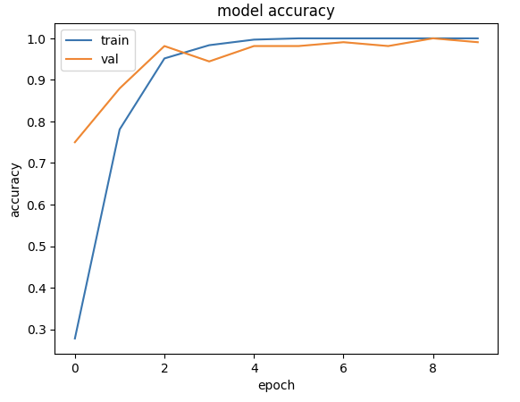
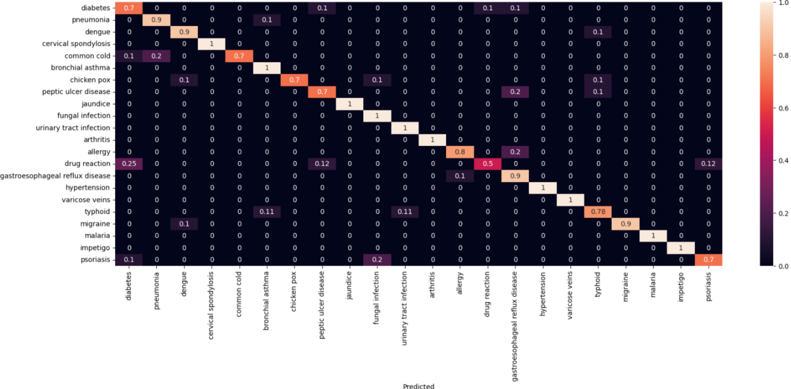
Key Figures
Baseline Model Performance
Confusion Matrix - Similar Diseases
Notes:
Janhavi
Here are some plots that show the training and validation accuracy for the BERT model, the model achieved a validation accuracy of 87%
However, the confusion matrix shows disease misclassification for

Slide 7
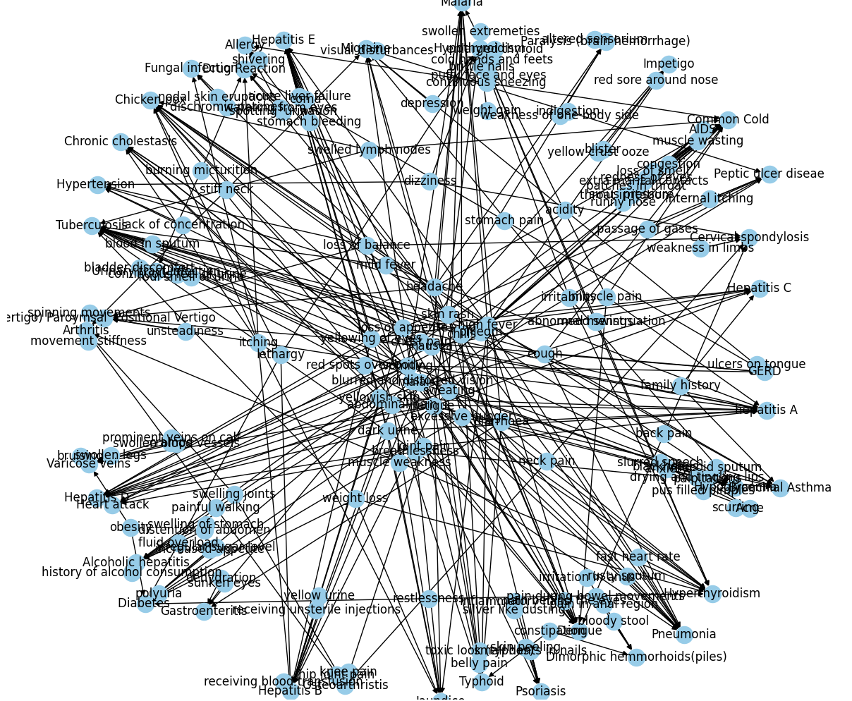
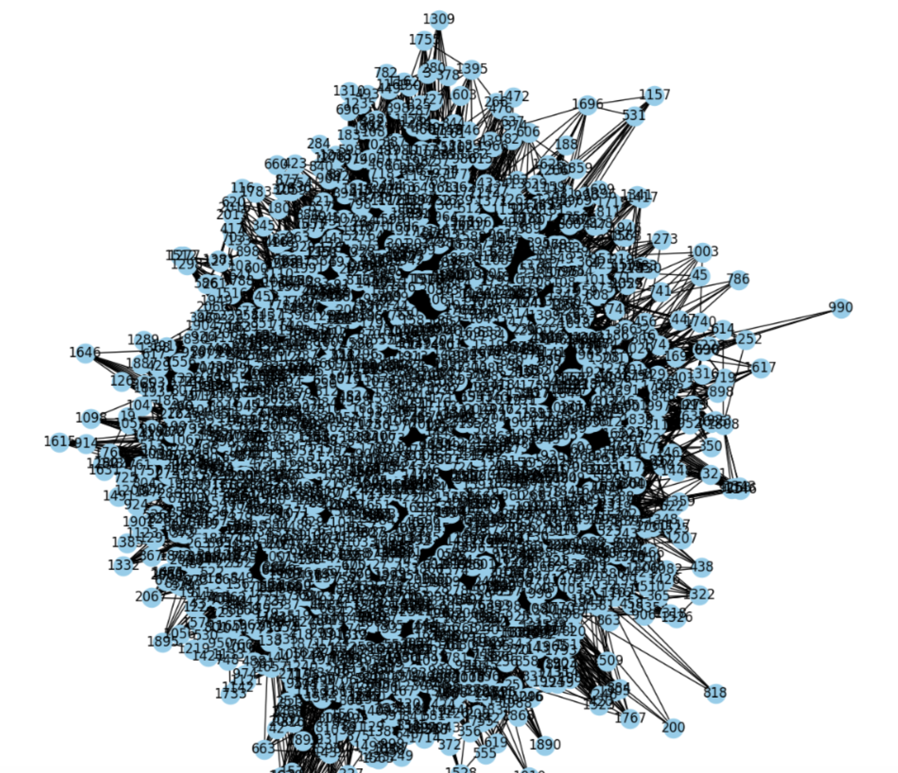
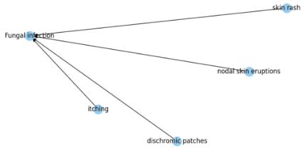
Key Figures
Knowledge Graph - All Diseases
Knowledge Graph with TF-IDF Vectors
Knowledge Graph - Single Disease
Notes:
Janhavi

Slide 8
Findings
Model | Loss | Precision | Recall | Macro F1
BERT (Training) | 0.505 | 0.87 | 0.87 | 0.87
Text GCN (Test) | 0.202 | 0.94 | 0.93 | 0.93
BERT model was prone to misclassification (i.e. confused common cold for pneumonia)
GCN model yielded more accurate results, as it did a better job capturing semantic relationships between diseases and symptoms; also involved:
Meticulous cleaning of patient narrative text
Introducing a knowledge graph based on TF-IDF vectors
Pointwise mutual information (PMI) calculations
Notes:
Janhavi

Slide 9
Conclusion & Next Steps
To enhance the capture of context and semantic relationships in textual data, we can consider integrating attention layers into the GCN or combining them with pre-trained transformers like BERT
If allotted more time, we would have liked to build a chatbot capable of processing user symptoms and returning classified illnesses and suggested remedies
Notes:
Janhavi

Slide 10
References
Wang, X., Chused, A., Elhadad, N., Friedman, C., \& Markatou, M. (2008). Automated knowledge acquisition from clinical narrative reports. AMIA ... Annual Symposium proceedings. AMIA Symposium, 2008, 783–787.
Kaggle (2022). Disease Symptom Prediction [Data set]. https://www.kaggle.com/datasets/itachi9604/disease-symptom-description-dataset?select=dataset.csv
Barman, N., Karim, F., Sharma, K. (2023). Symptom2Disease [Data set]. https://www.kaggle.com/datasets/niyarrbarman/symptom2disease/
Yuxing Lu, Xukai Zhao, and Jinzhuo Wang. 2023. Medical knowledge-enhanced prompt learning for diagnosis classification from clinical text. In Proceedings of the 5th Clinical Natural Language Processing Workshop, pages 278–288, Toronto, Canada. Association for Computational Linguistics.
Gupta, K. (2023, June 19). How to create and use a medical chatbot for medical diagnosis, symptom checking, and more - detailed guide. Tars Blog. https://www.hellotars.com/blog/how-to-create-and-use-a-medical-chatbot-for-medical-diagnosis-symptom-checking-and-more-detailed-guide/
Naveen. (2023, June 26). How to create a healthcare chatbot using NLP - kommunicate. Kommunicate Blog. https://www.kommunicate.io/blog/nlp-in-healthcare/
Yao, L., Mao, C., \&amp; Luo, Y. (2019). (rep.). Graph Convolutional Networks for Text Classification. Retrieved December 10, 2023, from https://arxiv.org/pdf/1809.05679.pdf.
Luo, H., Li, S.-W., \&amp; Glass, J. (2020). (rep.). Knowledge Grounded Conversational Symptom Detection with Graph Memory Networks. Retrieved December 10, 2023, from https://aclanthology.org/2020.clinicalnlp-1.16.pdf.

Slide 11
Questions?

